Slide 1
High Seas Allocation IP6 - Potential Criteria

Slide 2
Back to some of the starting questions:
The size of the limits,
The term (duration) of the allocation
Whether the allocation is a share of a variable limit, or as a set number of days or tonnes,
Whether the allocation is transferable
How new entrants are dealt with
If the allocation can change on the basis of use, fleet development or fleet reduction.

Slide 3

Allocation “criteria”
Family 1 – We paid for the food and need to be rewarded
Family 2 – We are a large family and need more food
Family 3 – We only have a small land allotment and therefore don’t have alternatives to this pig
Family 4 – It was our pig in the first place

Slide 4
A note of caution…
Remember the context!!
Talking about high seas allocations only
Primary focus on PS high seas allocation
Considerations are much different than if we were talking about EEZs

Slide 5
Catch or Effort History
Talked about this Monday – for limit setting – this is about dividing that limit up
Very common in most fisheries
Is a factor in most WCPFC related limits – BET LL, SWO, ALB, even most PS
Reflects “current participation” – ok if everyone has had equal opportunity to develop their fleet – which many haven’t in WCPFC.
Results in rewarding the pioneers at the expense of the latecomers
Would lock out those FFA members not currently fishing on the high seas
Would lock those with fishing fleets to previous levels not necessarily reflective of aspirations
Likely to be a strong push to include in some way because of precedent and direct link to 10 (3) (b) and (c)
Can build in flexibility through choosing periods that maximise FFA interests

Slide 6
Economic Dependency/Contribution
Strongly supported by the Convention: 10 (3) (b), (d), (g) and (j)
Generally a concept that plays into the favour of FFA members
Difficult to consider though in the context of high seas only allocation:
If it’s current dependency – isn’t that just catch history?
If it’s aspirational dependency – how do you quantify it and compare it to others.
If used in raw form at least three developed CCM fleets could make a case of dependency on the high seas
Could be linked to development status (below)?

Slide 7
Equal Shares
Simple in concept
Previous FFC position “at least equal”
Responds to some aspects of the Convention (10 (3) (d), (e) and (j))
Depending on limit could facilitate increased participation by SIDS (UNFSA 25)
Could come at the expense of those already fishing
Need to decide who is equal – Commission Members? Participating Territories? CNMs?

Slide 8
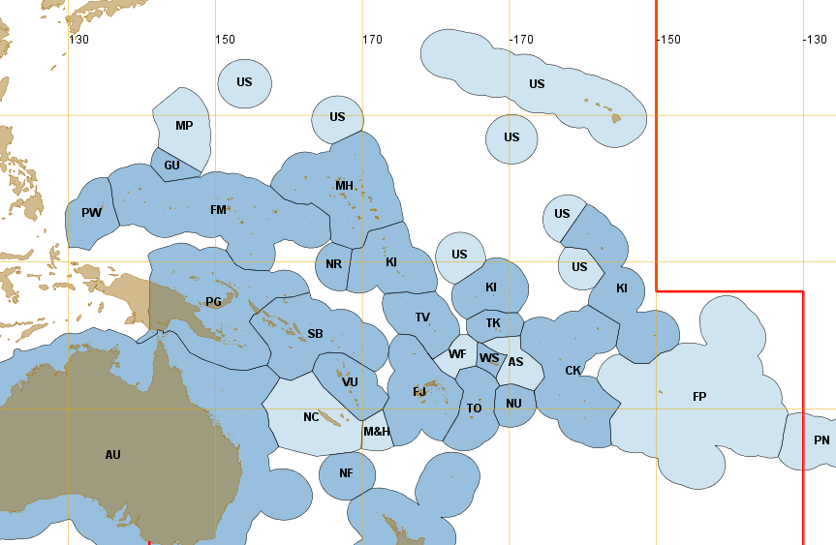
Adjacency
Those who are closest to the high seas fishing areas have the most at stake
Would advantage some
FFA members potentially
at the cost of others
What is “adjacent”?
Difficult ROP experience
10 (3) (d), (g) and (j)

Slide 9
Development Status
Article 30 specifically included in the TT CMM
Development status must be built in either explicitly or implicitly
But many ways to consider it:
Simple – broad categories such as SIDS, developing coastal State, other
Using an index:
Relative wealth (GDP or GNI)
Other development factors (Human Development Index)
10 (3) (d) and (j), as well as Article 30 and UNFSA 25

Slide 10
Special Circumstances
An invariable component of any allocation – impossible to design a set of criteria or an allocation formula that meets everyone’s needs
Sometimes nothing to do with fisheries
Assuming good faith (bold assumption?) – can be dealt with case by case.
Current measures contain numerous examples of special circumstances:
SIDS exemptions, alternative baselines (China, US, fleets less than 5), negotiated top-ups (US, EU, NZ), etc
2 examples in Convention: Samoa (3)(h) and Kiribati (3)(i).
Non-PNA SIDS - concept of “disadvantage” – likely to be claimed by others including American Samoa
Trick is to balance solutions to special circumstances

Slide 11
Summary
Lots of potential criteria
Those listed here could directly address 8 of the 10 principles in the Convention
Some will suit some and others will suit others…
Need to consider all of them even if we think we don’t like them
What do we want to propose?
What are others likely to propose?

